Slide 1


GBME Probability and Statistics | Fall 2018
Lecture 01 | 090318
Lecture 01
Course overview, Statistics?
CHOONG-WAN WOO | COCOAN lab | http://cocoanlab.github.io

Slide 2
Lecture 01 | 090318
Hi everyone,
Look around.
Meet your classmates.
Let’s introduce yourself!
Name?
Which department? Maybe GBME?
What year are you in?
What is your study interest?
What is your career goal?
Also:
Any experience in stats, data analysis, data science?
What do you want to learn from the class?
Let’s collect some data!
How many hours did you sleep last night?
How many do you sleep on average?
CHOONG-WAN WOO | COCOAN lab | http://cocoanlab.github.io

Slide 3
Lecture 01 | 090318
Course overview
GBME’s Probability and Statistics
Class code: GBE 3037
Intro Stats
Textbook: "Stats: Data and Models" by De Veaux, Velleman, and Bock, Fourth Edition
Third edition also works!
CHOONG-WAN WOO | COCOAN lab | http://cocoanlab.github.io

Slide 4
Lecture 01 | 090318
Course overview
GBME’s Probability and Statistics
Class code: GBE 3037
Intro Stats
Textbook: "Stats: Data and Models" by De Veaux, Velleman, and Bock, Fourth Edition
Third edition also works!
You can get free PDF of the third edition:
https://acwang.files.wordpress.com/2015/08/stats-data-and-models-3rd-edition-richard-d-de-veaux.pdf
Two useful web-based platforms for the class:
GitHub for posting class-related materials, assignments, data, codes, etc
Piazza for class-related discussion and questions
CHOONG-WAN WOO | COCOAN lab | http://cocoanlab.github.io

Slide 5
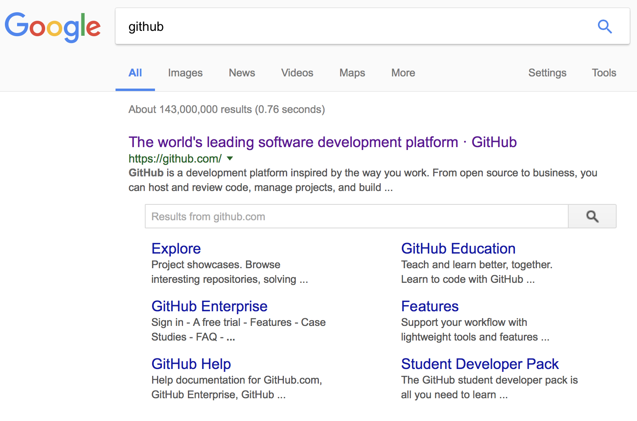
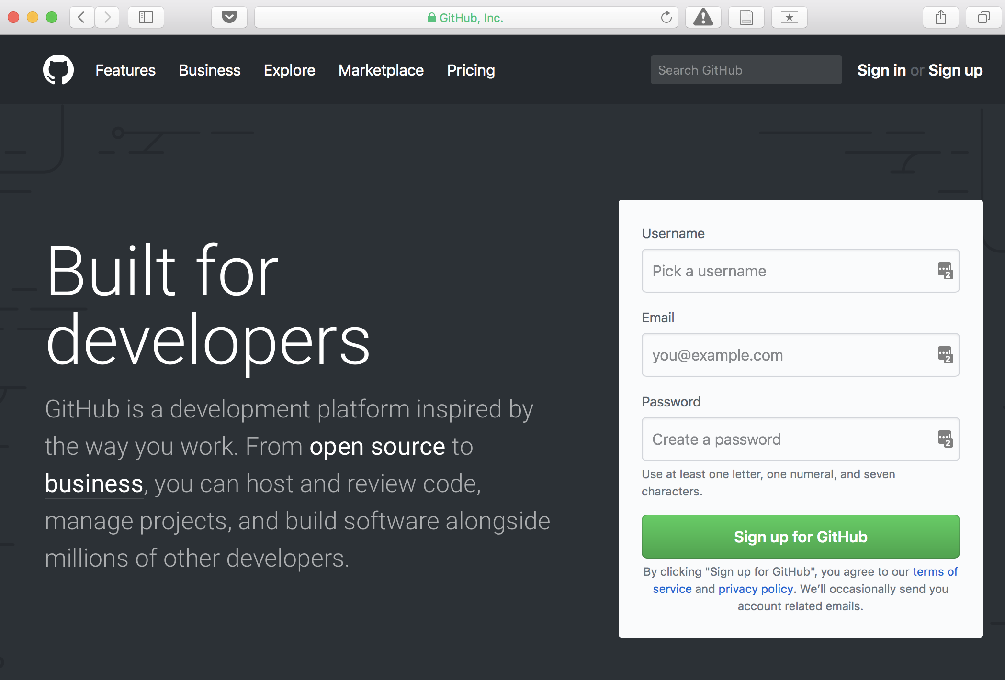
Lecture 01 | 090318
Most popular software development platform: version control, easy-sharing scripts and data, etc.
CHOONG-WAN WOO | COCOAN lab | http://cocoanlab.github.io

Slide 6
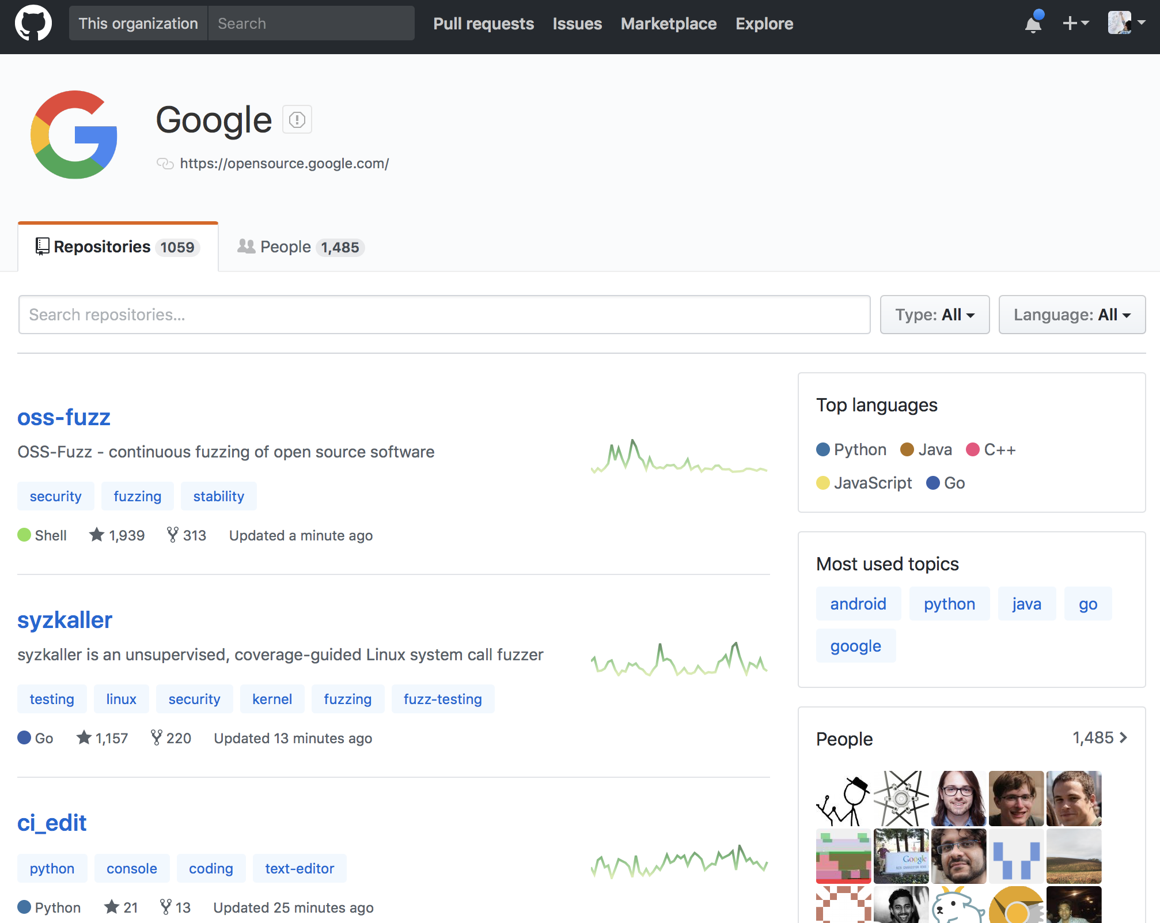
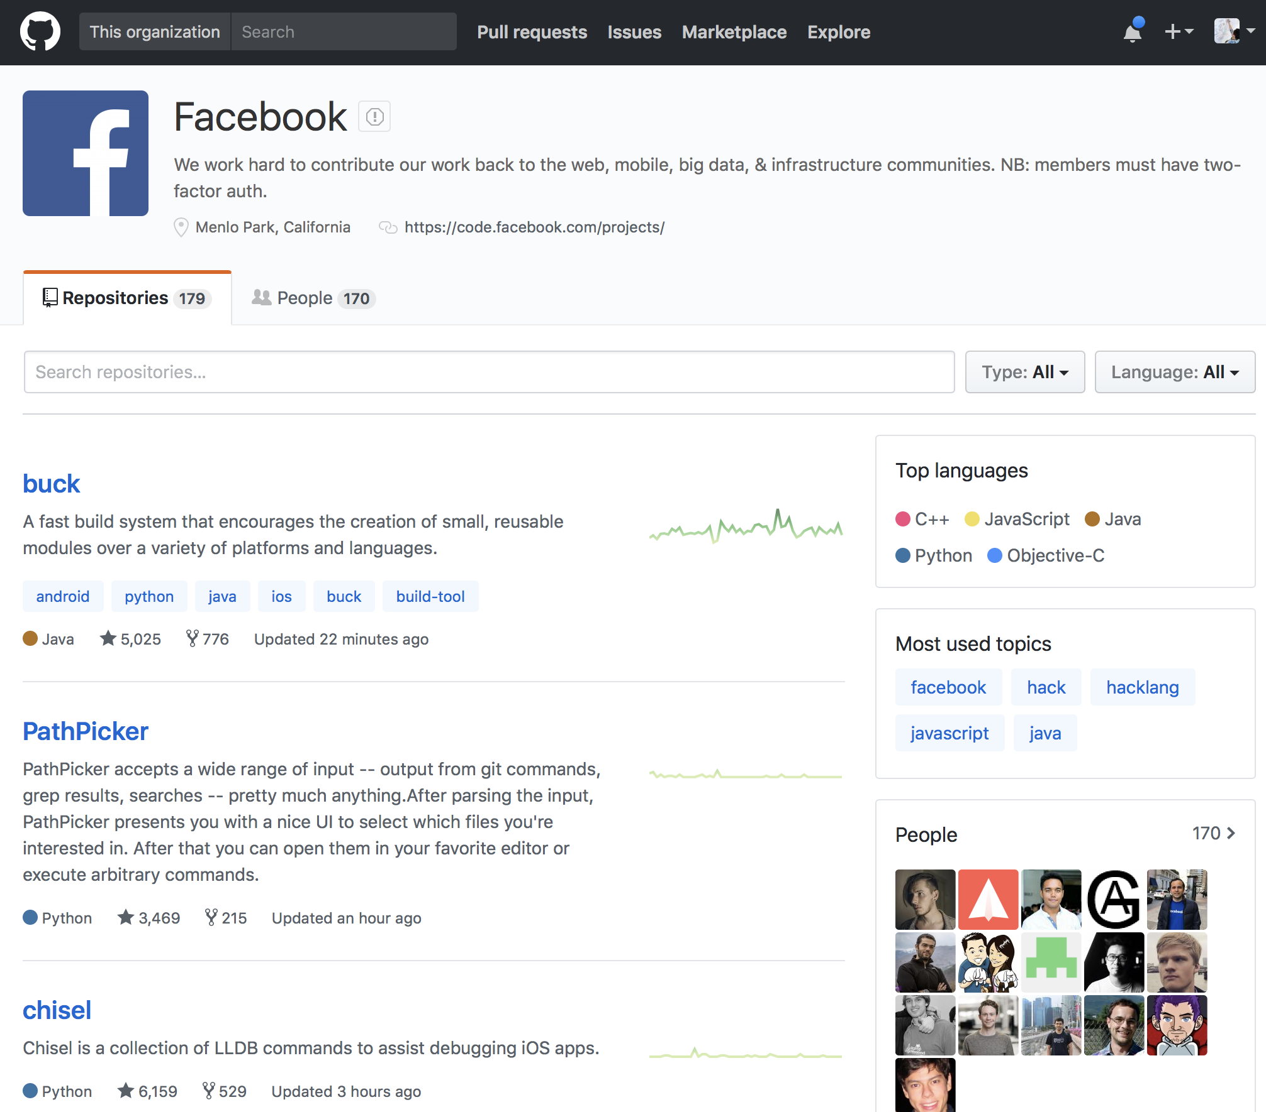
Lecture 01 | 090318
Most popular software development platform: version control, easy-sharing scripts and data, etc.
Everyone uses GitHub for the development, including Google, Facebook, etc.
CHOONG-WAN WOO | COCOAN lab | http://cocoanlab.github.io

Slide 7
Lecture 01 | 090318
Most popular software development platform: version control, easy-sharing scripts and data, etc.
Everyone uses GitHub for the development, including Google, Facebook, etc.
More and more people are creating and sharing a GitHub repository for their research and publications:
CHOONG-WAN WOO | COCOAN lab | http://cocoanlab.github.io

Slide 8
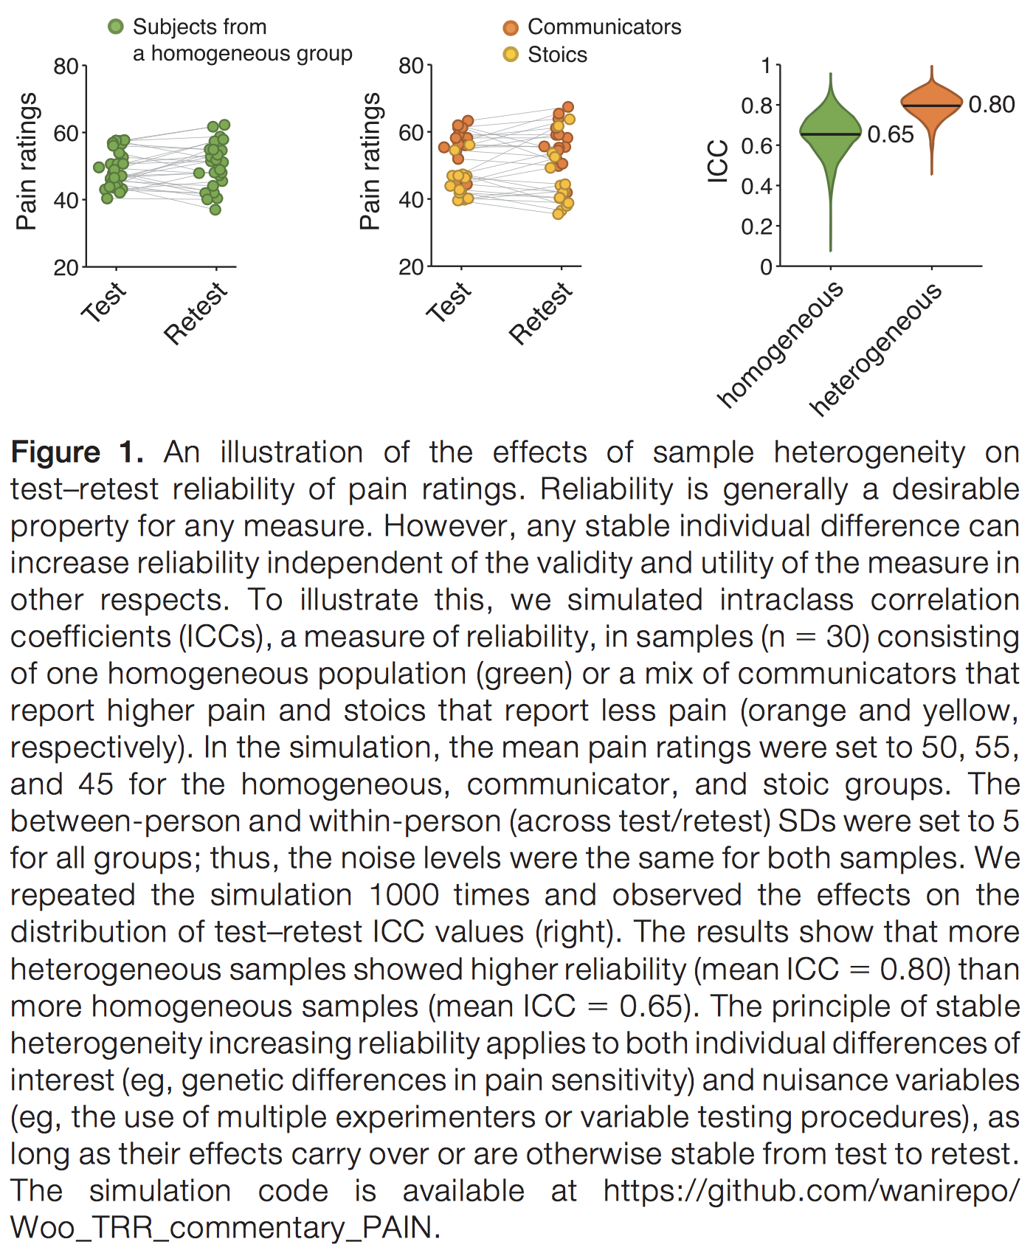
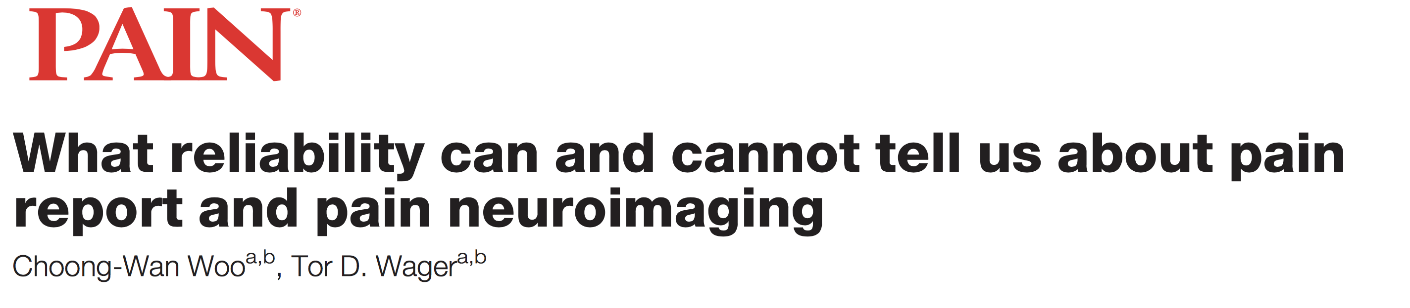
Lecture 01 | 090318
Most popular software development platform: version control, easy-sharing scripts and data, etc.
Everyone uses GitHub for the development, including Google, Facebook, etc.
More and more people are creating and sharing a GitHub repository for their research and publications:
E.g., Woo & Wager, 2016, PAIN
CHOONG-WAN WOO | COCOAN lab | http://cocoanlab.github.io

Slide 9
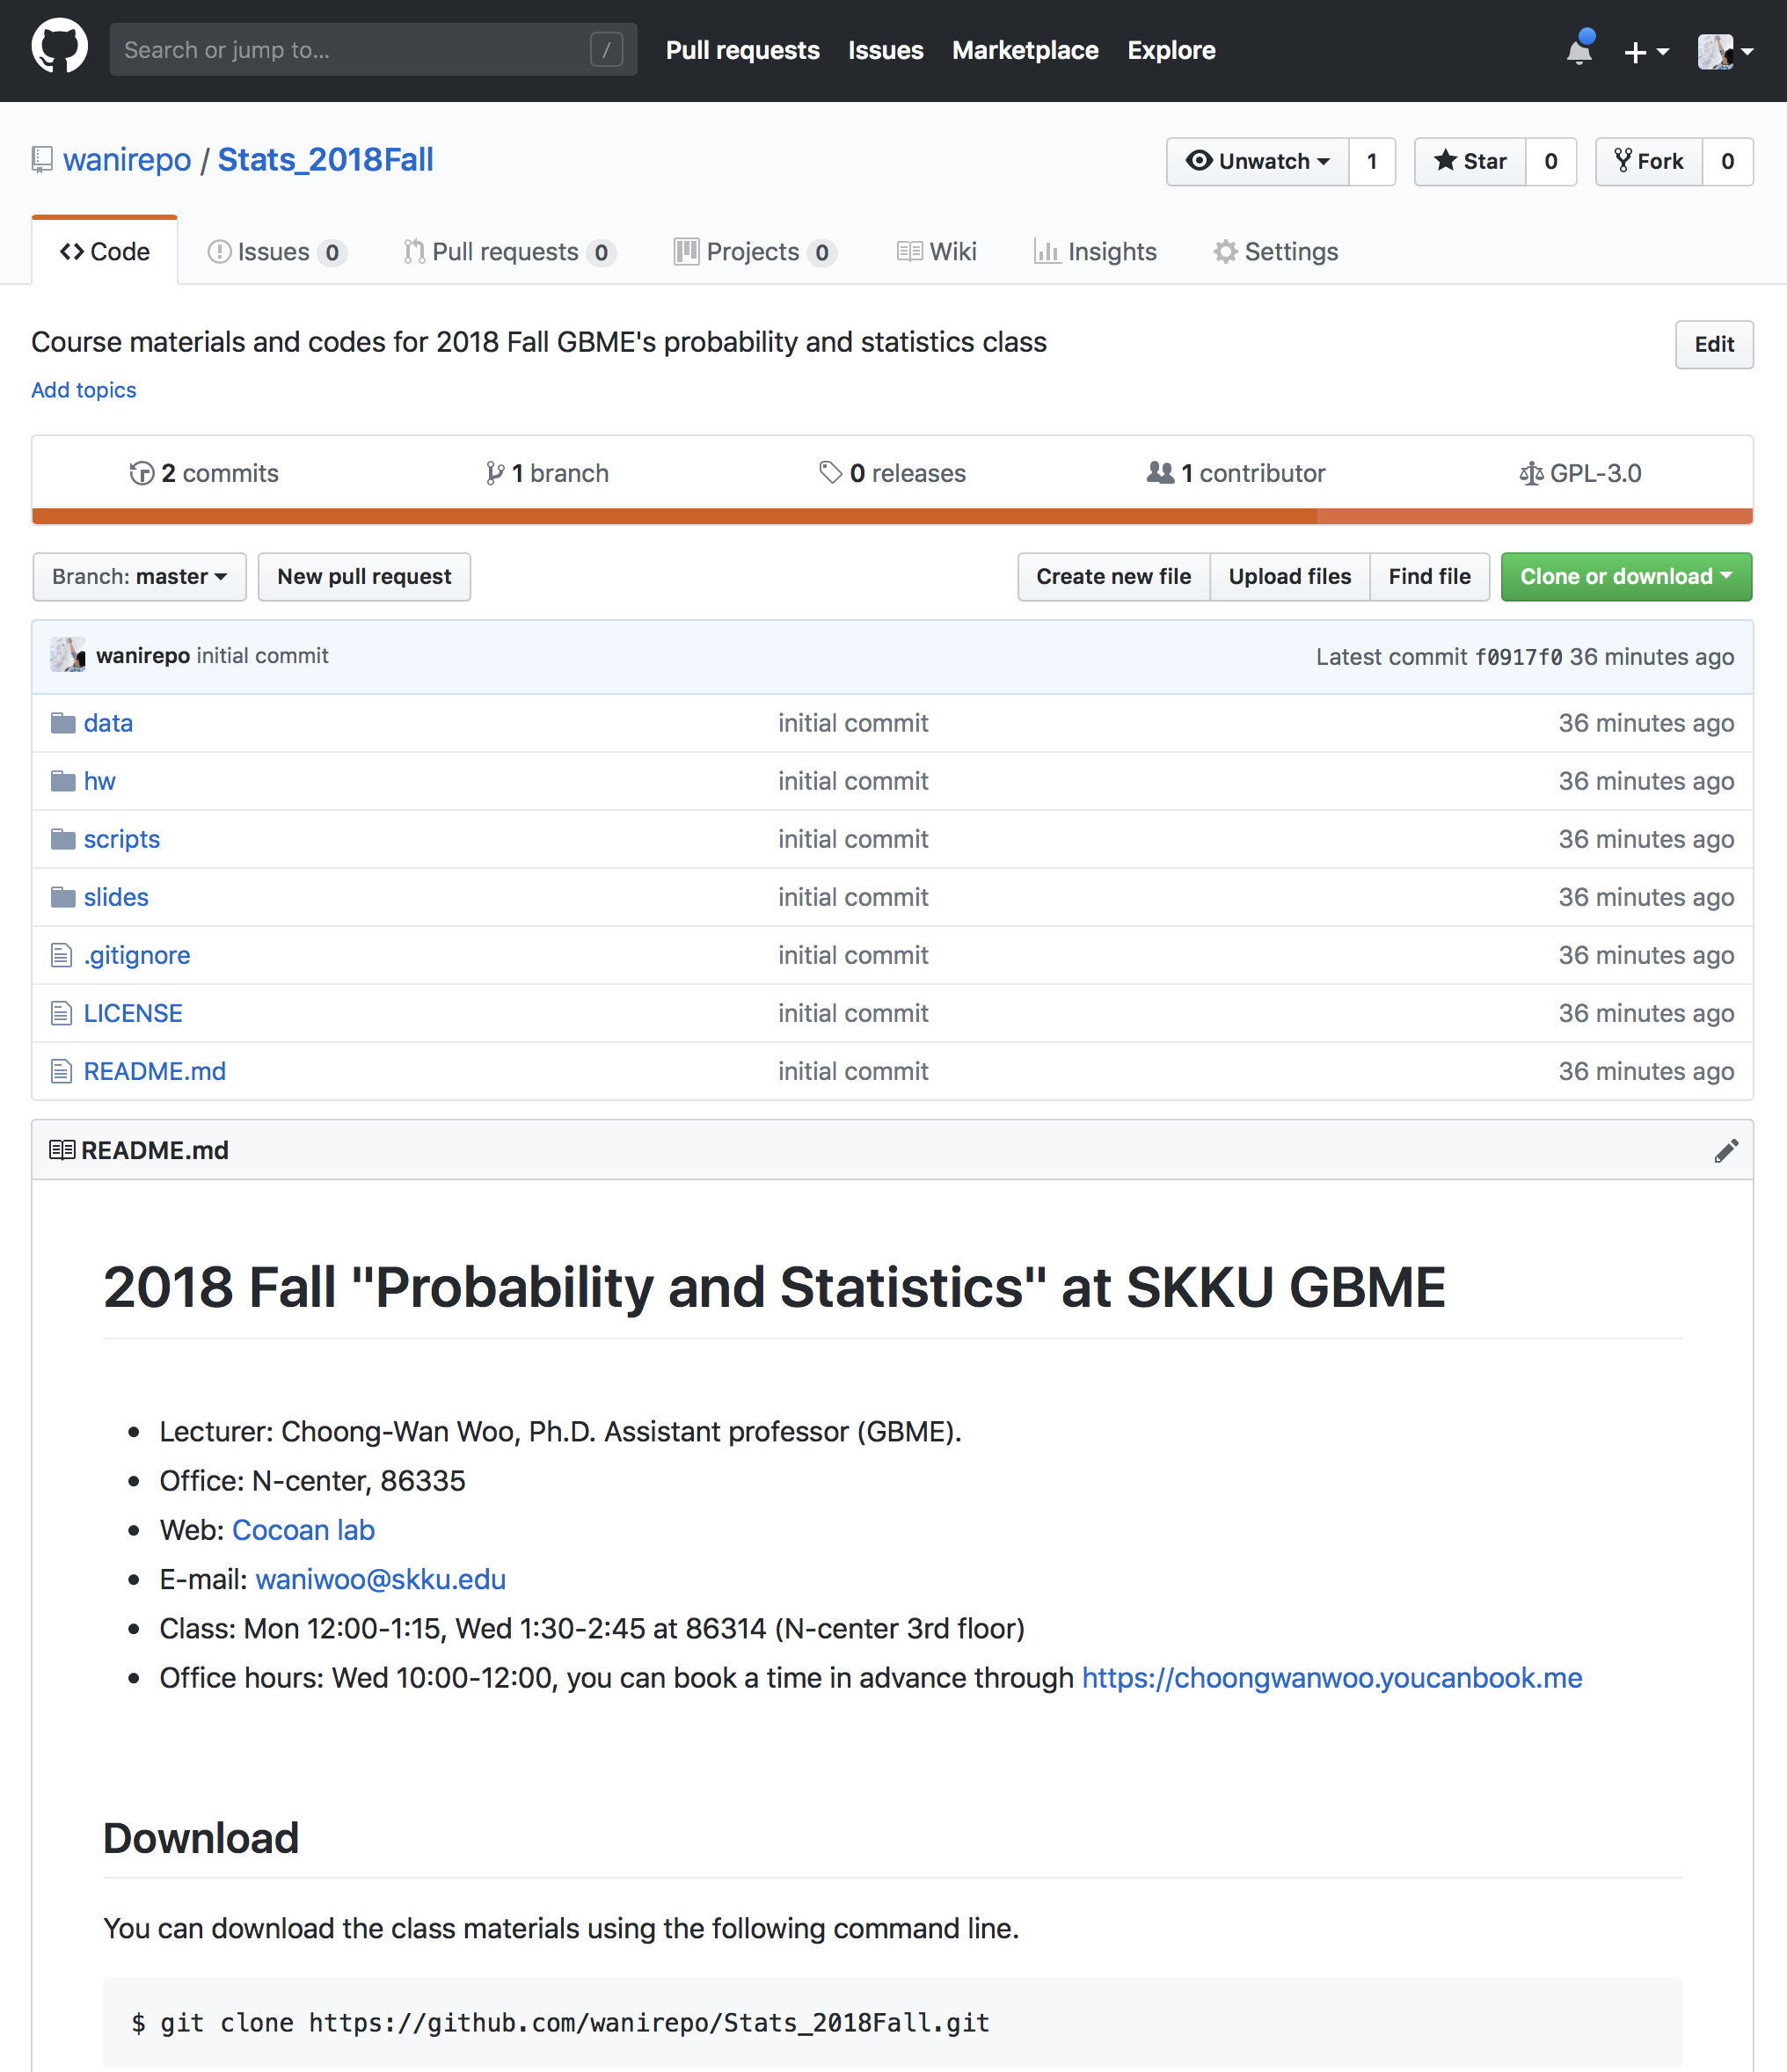
Lecture 01 | 090318
Our class website: https://github.com/wanirepo/Stats_2018Fall
README.md is the syllabus.
Let’s visit the website, and read the syllabus.
CHOONG-WAN WOO | COCOAN lab | http://cocoanlab.github.io

Slide 10
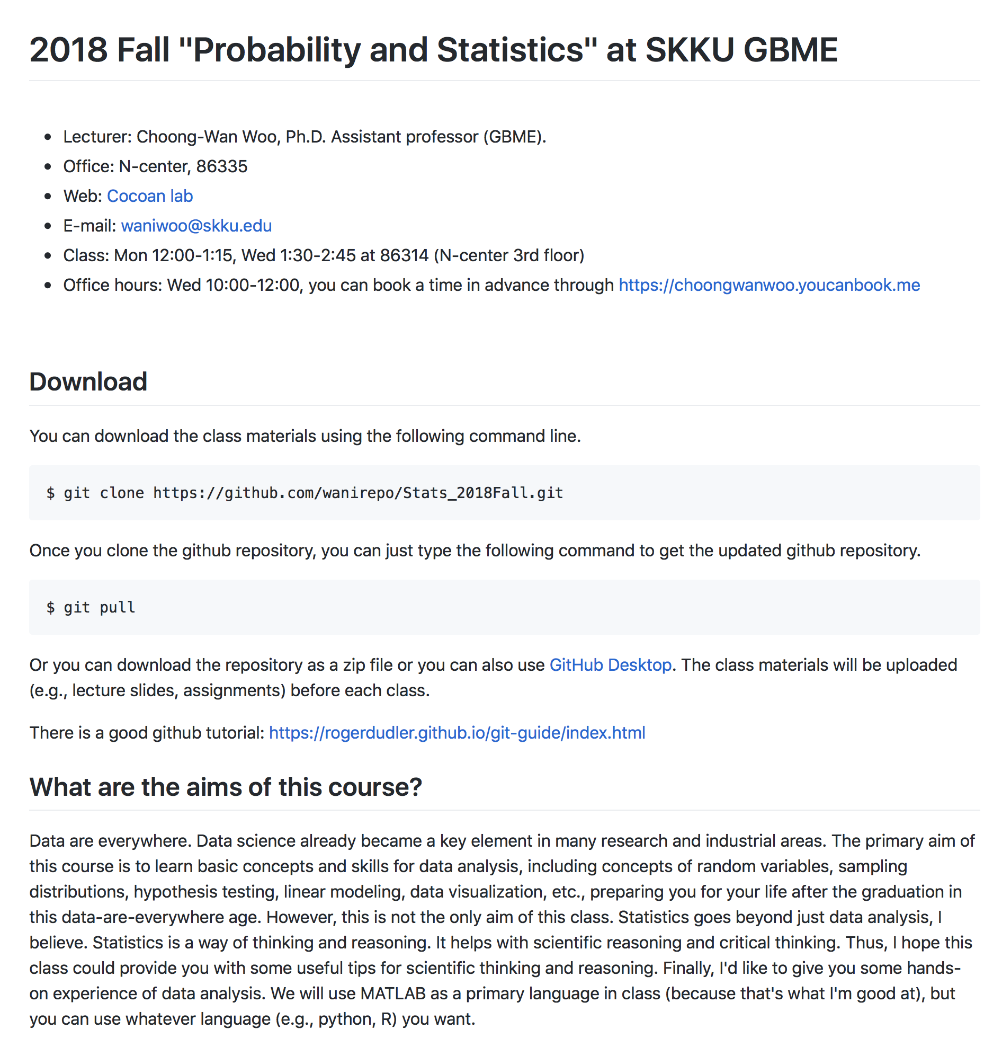
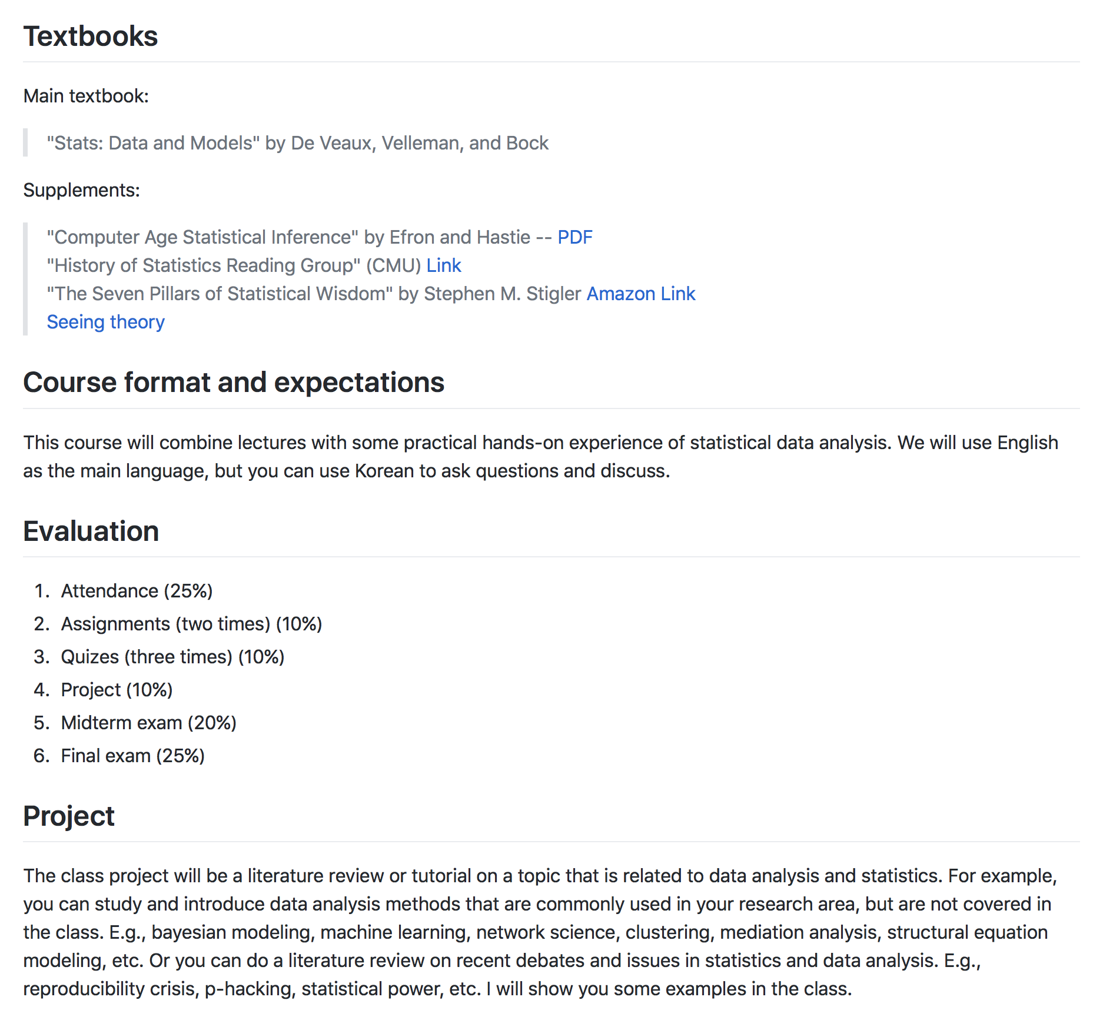
Lecture 01 | 090318
https://github.com/wanirepo/Stats_2018Fall/blob/master/README.md
CHOONG-WAN WOO | COCOAN lab | http://cocoanlab.github.io

Slide 11
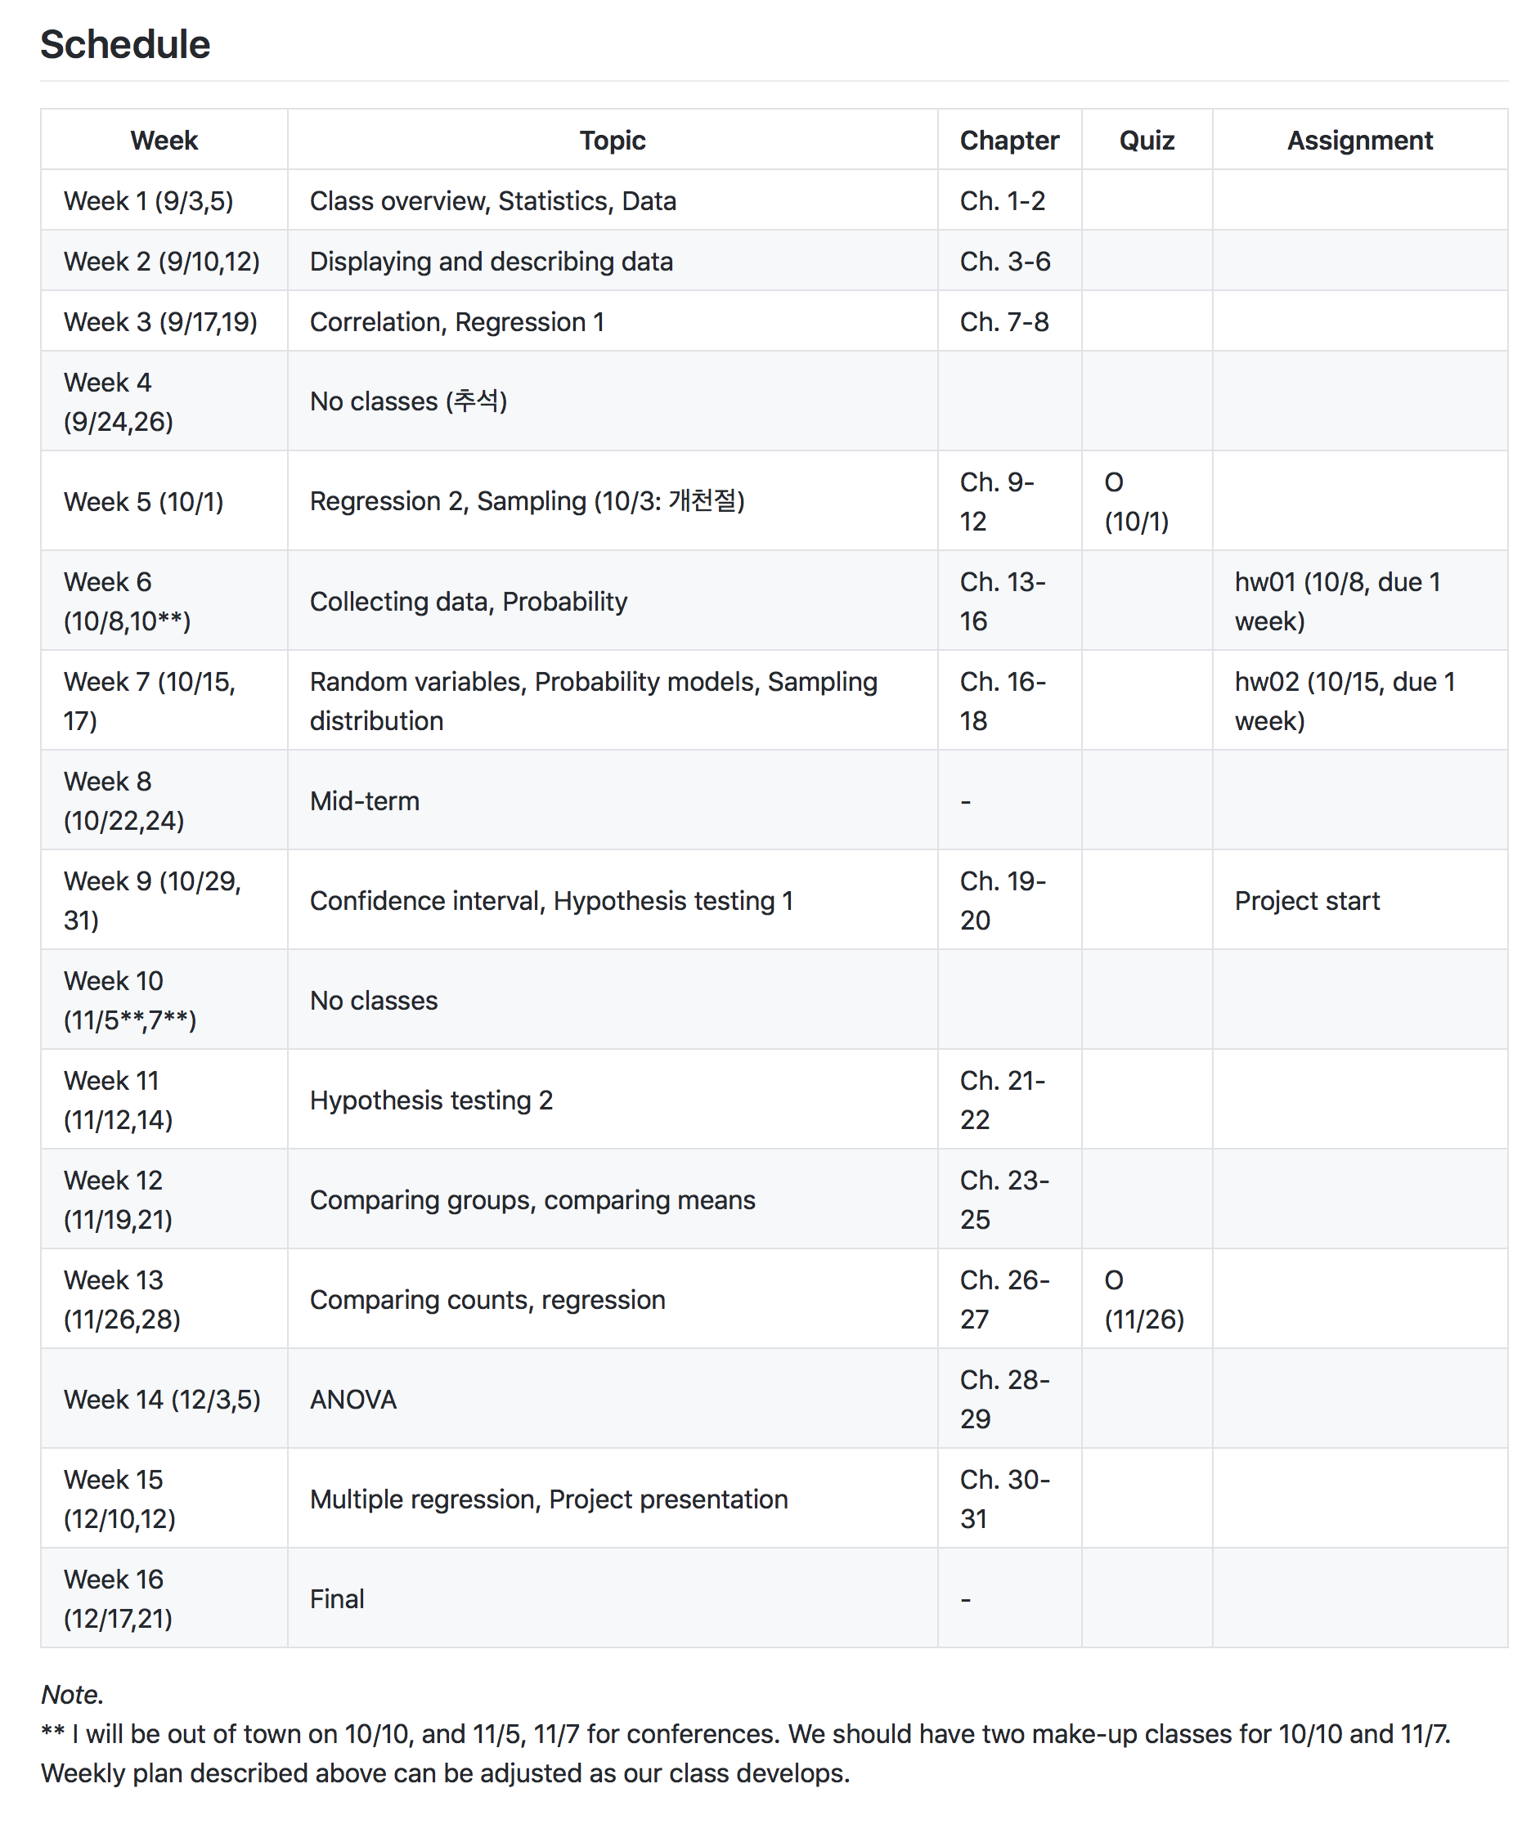
Lecture 01 | 090318
https://github.com/wanirepo/Stats_2018Fall/blob/master/README.md
Please note that: this schedule is tentative, and can be adjusted as our class develops.
CHOONG-WAN WOO | COCOAN lab | http://cocoanlab.github.io

Slide 12
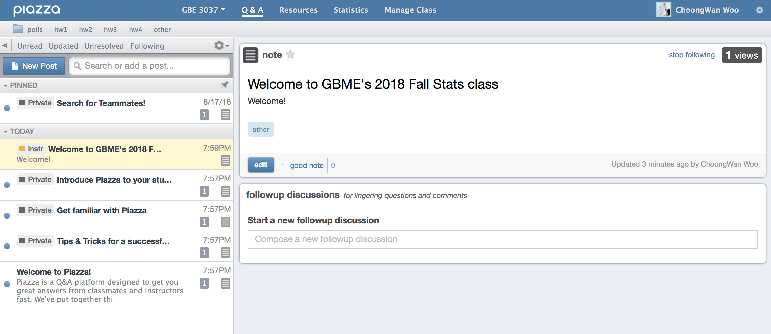
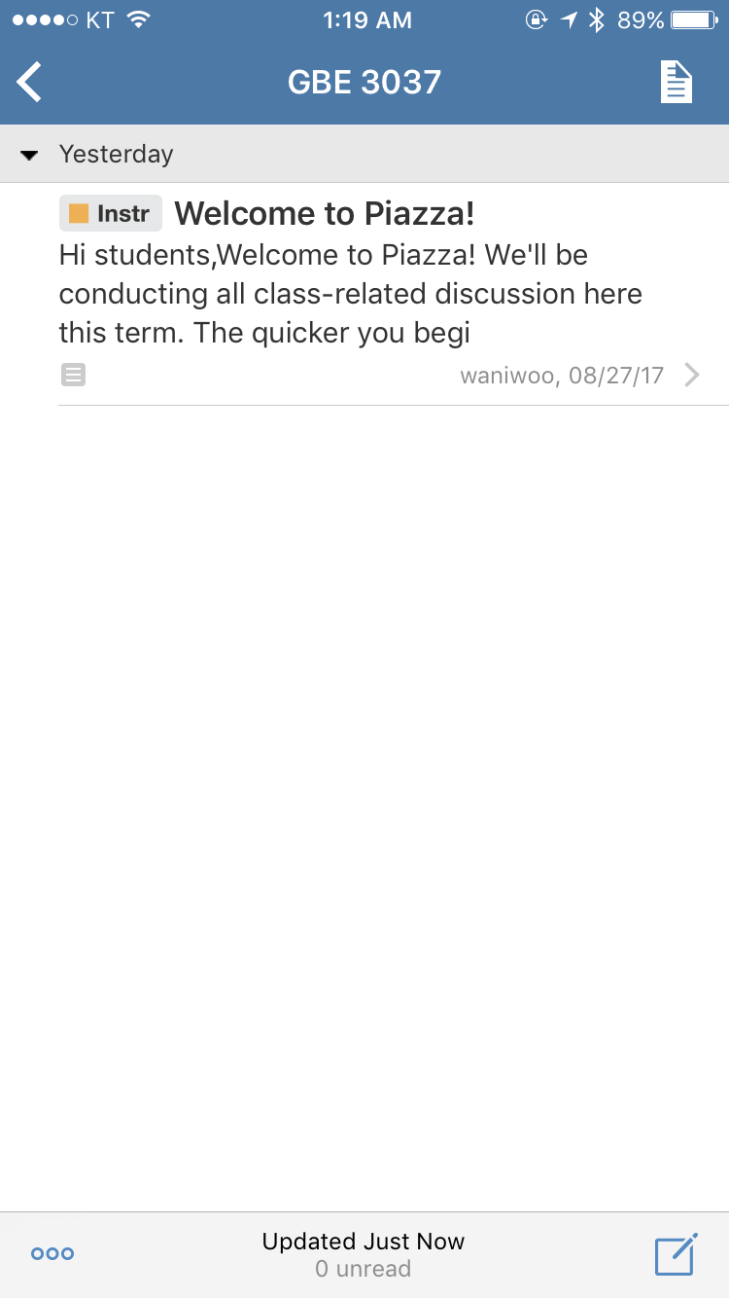
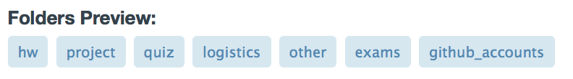
Lecture 01 | 090318
A great platform for class-related discussions and questions.
You can sign up for the class here: https://piazza.com/sungkyunkwan_university/fall2018/gbe3037/home
Mobile version
CHOONG-WAN WOO | COCOAN lab | http://cocoanlab.github.io

Slide 13
Lecture 01 | 090318
To-do before the next class
Sign up for GitHub and Piazza
Download the textbook PDF! and read the first two chapters.
https://acwang.files.wordpress.com/2015/08/stats-data-and-models-3rd-edition-richard-d-de-veaux.pdf
CHOONG-WAN WOO | COCOAN lab | http://cocoanlab.github.io

Slide 14
Lecture 01 | 090318
To-do before the next class
Sign up for GitHub and Piazza
Download the textbook PDF! and read the first two chapters.
https://acwang.files.wordpress.com/2015/08/stats-data-and-models-3rd-edition-richard-d-de-veaux.pdf
CHOONG-WAN WOO | COCOAN lab | http://cocoanlab.github.io

